Slide 1
Rule-Making Process
Washington State Register
Office of the Code Reviser

Slide 2
Washington State Register Web Page https://leg.wa.gov/CodeReviser/Pages/Washington_State_Register.aspx

Slide 4
Statutes and Rules for Rule Making
Administrative Procedure Act Chapter 34.05 RCW
Rule Making Chapter 1-21 WAC

Slide 5
More Statutes for Rule Making
Regulatory Fairness Act (Small Business Impact) Chapter 19.85 RCW
Open Public Meetings Act Chapter 42.30 RCW

Slide 6
The Basic Filing Procedures

Slide 7
Rule-Making Processes
Permanent Process
3 Steps
Expedited Permanent Process
2 Steps
Emergency Process
1 Step

Slide 8
PERMANENT PROCESS
Step 1
File Preproposal Statement of Inquiry on a CR-101 form.
No WAC text needed.
Needs to be published 30 days before moving to Step 2. Use the calendar on the next page to determine the earliest you should file your CR-102.

Slide 9
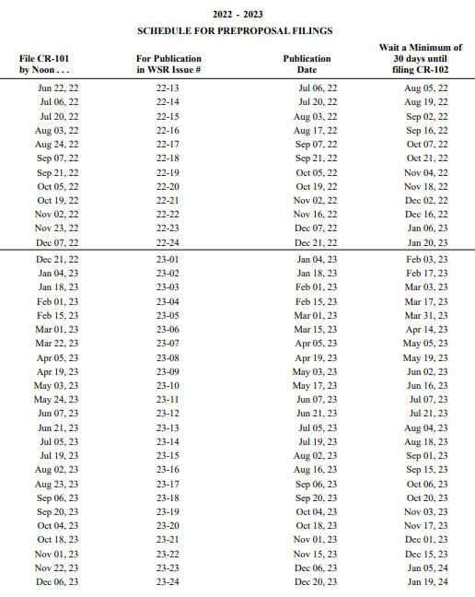
PERMANENT PROCESS

Slide 10
ORDER TYPING SERVICE Prepare Rules For Filing

Slide 11
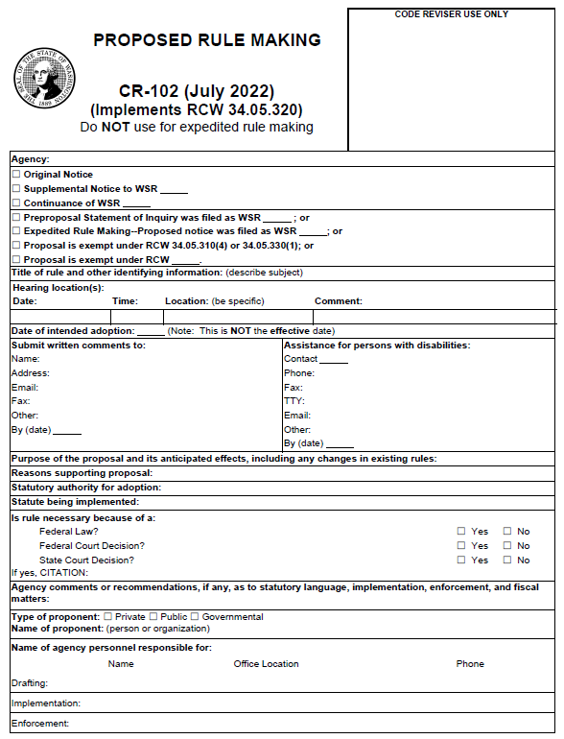
PERMANENT PROCESS
Step 2
File CR-102 with proposed text attached (shown in bill drafting style with ((strike through)) and underscoring).
Must be published 20 days before a public hearing can be held and adoption can take place. Use the calendar on the next page to determine the earliest you can have a hearing and adopt rules.
Page 1

Slide 12
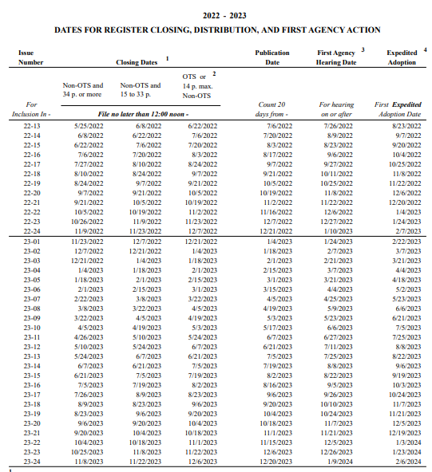
PERMANENT PROCESS

Slide 13
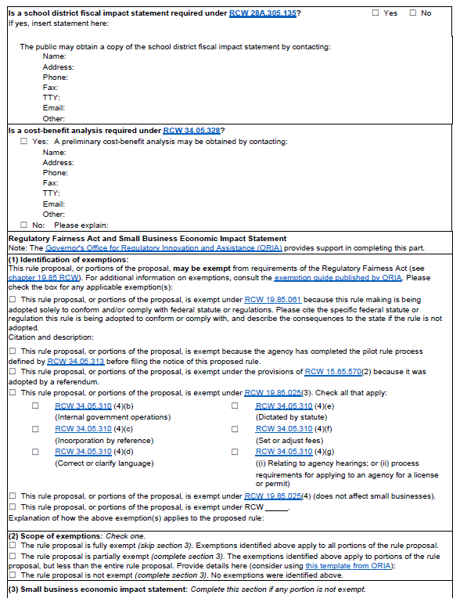
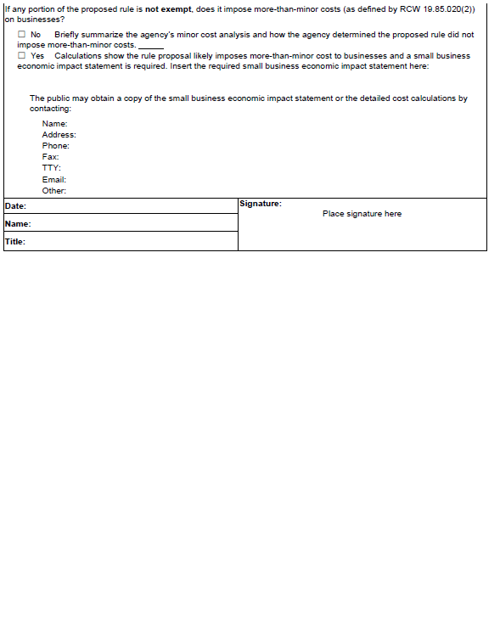
PERMANENT PROCESS – Step 2 cont.
Page 2
Page 3

Slide 14
PERMANENT PROCESS
Step 3
Adoption and filing cannot take place before the stated “Date of Adoption” on the CR-102.
File CR-103P with text attached in bill drafting style (even if the text is the same as the proposal).
Page 1

Slide 15
PERMANENT PROCESS
Step 3 cont.
Permanent rule becomes effective 31 days after filing with the office of the code reviser (there are exceptions).
Sections will be codified into the WAC base.
Page 2

Slide 16
EXPEDITED PERMANENT PROCESS
Step 1
File CR-105 form with proposed text attached in bill drafting format.
Must wait 45 days from publication of the CR-105 before moving to Step 2. Tip: In calculating the 45 days, it is easiest to use the closing date calendar because RCW 1.12.040 has to be taken into account when calculating days.
Page 1

Slide 17
EXPEDITED PERMANENT PROCESS
Step 1 cont.
Note: If any objection to the CR-105 is filed with agency and not withdrawn, the CR-105 becomes the equivalent of the CR-101, and a CR-102 may then be filed to hold a hearing.
Page 2

Slide 18
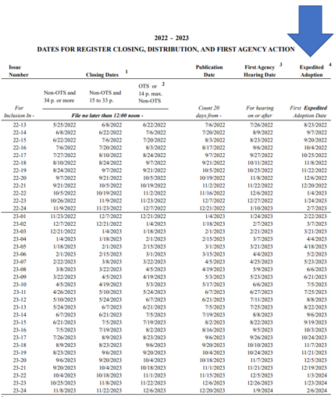
EXPEDITED PERMANENT PROCESS

Slide 19
EXPEDITED PERMANENT PROCESS
Step 2
If there are no objections, the agency submits a CR-103P form with text attached (just like the regular process), and rules go into effect 31 days after filing with the office of the code reviser.
Page 2

Slide 20
EMERGENCY PROCESS
Only one step
File CR-103E with text attached in bill drafting format.
Emergency is in effect 120 days from filing.
Page 1

Slide 21
EMERGENCY PROCESS
Cont.
An emergency can be filed a second time if the agency is in the process of permanently adopting the rules pursuant to RCW 34.05.350(2).
Page 2

Slide 22
For Further Information Please Contact:
For information about the rules process:
For information about the computer technology:
Jennifer Meas
360-786-6697
Jennifer.Meas@leg.wa.gov
John Shiflett
360-786-6371
John.Shiflett@leg.wa.gov
WAC Editor – Trudee Turner
360-786-6687
Trudee.Turner@leg.wa.gov
Order Typing Service – Pam Kirschbaum
360-786-6672
Pamela.Kirschbaum@leg.wa.gov

